Slide 1
Lecture 27~28: Concurrency
Java Programing
https://docs.oracle.com/javase/tutorial/essential/concurrency/index.html

Slide 2
Concurrent Software

Slide 3
Single vs. Multiple processors
Single vs. Multiple cores

Slide 4
Processes and Threads

Slide 5
A process
A self-contained execution environment
A complete, private set of basic run-time resources
e.g., has own memory space
c.f. an application = a set of cooperating processes (# of processes >= 1)

Slide 6

Processes in Windows (Resource Monitor App)
CPU cores

Slide 7

Processes in Mac (Active monitor, Windows > CPU Usage)

Slide 8
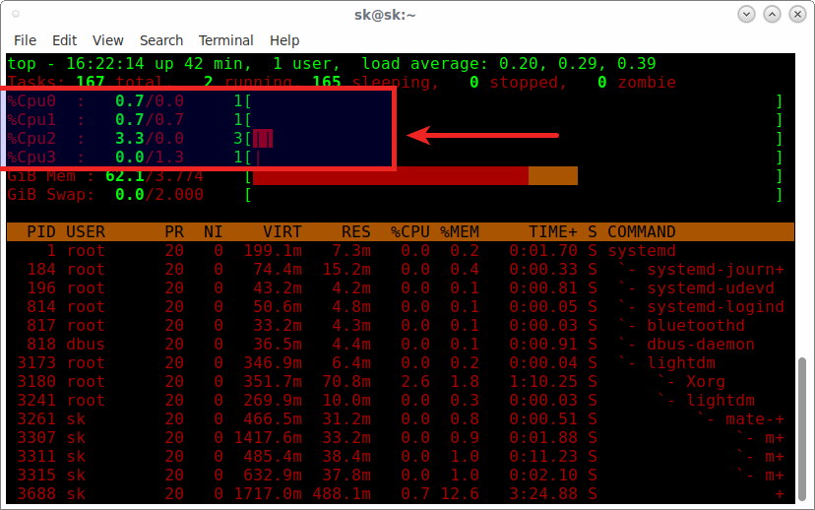
Processes in Linux (top in terminal)
$ top
To see cores, press 1.

Slide 9
Threads
Sometimes called 'lightweight processes'
Creating a new thread requires fewer resources than creating a new process.
Threads exist within a process.
Every process has at least one thread (main thread).
Threads share the process's resources including memory and open files.

Slide 10
Thread programming
All examples
https://github.com/lifove/ThreadExamples

Slide 11
Thread programming
Two ways to define and start threads
Pausing Execution with Sleep
Interrupts
Joins

Slide 12
Two ways to define and start threads
Runnable interface
Thread class

Slide 13
Thread programming using a Runnable Object
implements Runnable interface
add code executed in a thread in the run() method
public class HelloRunnable implements Runnable {
public void run(){
System.out.println("Hello from a thread!");
}
public static void main(String args[]) {
Thread myThread = new Thread(new HelloRunnable ());
myThread.start();
}
}
https://github.com/lifove/ThreadExamples/blob/master/src/main/java/edu/handong/csee/java/examples/thread/HelloRunnable.java

Slide 14
Thread programming using the Thread class
subclass (extends) Thread
public class HelloThread extends Thread {
public void run(){
System.out.println("Hello from a thread!");
}
public static void main(String args[]) {
HelloThread myThread = new HelloThread();
myThread.start();
}
}
https://github.com/lifove/ThreadExamples/blob/master/src/main/java/edu/handong/csee/java/examples/thread/HelloThread.java

Slide 15
Implements Runnable vs. extends Thread
Employing Runnable is more general
Can make an existing class that already extends a class other than the Thread class support a thread.
Extending the Thread class is easier to use in simple applications
but cannot extend other classes.

Slide 16
Thread programming
Two ways to define and start threads
Pausing Execution with Sleep
Interrupts
Joins

Slide 17
Pausing
Thread.sleep
// Pause 4 seconds
Thread.sleep(4000);
https://github.com/lifove/ThreadExamples/blob/master/src/main/java/edu/handong/csee/java/examples/thread/SleepMessages.java

Slide 18
Thread programming
Two ways to define and start threads
Pausing Execution with Sleep
Interrupts
Joins

Slide 19
Interrupt
An indication to a thread that it should stop.
Sometimes, we need to stop a thread when it is interrupted.

Slide 20
Thread programming
Two ways to define and start threads
Pausing Execution wit Sleep
Interrupts
Joins

Slide 21
Joins
The join method allows one thread to wait for the completion of another.
e.g.,
t.join();
If t is a Thread object whose thread is currently executing, t.join(); causes the current thread to pause execution until t's thread terminates.
t.join(5000);
If t is a Thread object whose thread is currently executing, t.join(); causes the current thread to pause execution for '5000' milliseconds AT MOST until t's thread terminates.

Slide 22
Simple Threads Example with interrupt and joins
https://github.com/lifove/ThreadExamples/blob/master/src/main/java/edu/handong/csee/java/examples/thread/SimpleThreads.java

Slide 23
Lecture 28: Concurrency (2)
Java Programing
https://docs.oracle.com/javase/tutorial/essential/concurrency/index.html

Slide 24
Thread Pool

Slide 25
Why to use the thread pool
There is overhead in thread creation.
e.g., Thread object use a significant amount of memory → In a large-scale application, allocating and deallocating many thread objects creates a significant memory management overhead.
Context switch also causes overhead.

Slide 26
How to use a thread pool
ExecutorService class
Provides methods to manage termination of asynchronous tasks (i.e., threads).
https://docs.oracle.com/javase/7/docs/api/java/util/concurrent/ExecutorService.html
Supports a thread pool so that it can allow the fixed number of threads operates and others are waiting in a queue. When one of threads is terminated, the next thread in the queue is executed.
The instance of ExecutorService must call shutdown() which will not accpet and wait for new threads to be executed.
Example
https://github.com/lifove/ThreadExamples/tree/master/src/main/java/edu/handong/csee/java/examples/thread/pool

Slide 27
How to use a thread pool for your CPU cores.
Coding Steps
Get the number of your cores
int numOfCoresInMyCPU = Runtime.getRuntime().availableProcessors();
Set the thread pool by using Executor service
ExecutorService executor = Executors.newFixedThreadPool(numOfCoresInMyCPU);
In a loop
Instantiate a Runnable class with your class that implements Runnable interface.
Runnable worker = new YourThreadClass();
Call executor with the Runnable instance
executor.execute(worker);
Call shutdown() not to accept any new threads
executor.shutdown()
The main thread must be wait in case you want for all threads are joining into the main thread.
while(!executor.isTerminated()){}

Slide 28
Code together ChatCounter with threads in reading data files.

Slide 29
Advanced Topics
Synchronization
Liveness
Guarded Blocks
Immutable Objects
https://docs.oracle.com/javase/tutorial/essential/concurrency/sync.html
Study by yourself if you are interested in! You will learn most topics in Operating System.

Slide 30
Synchronization
c++
1. Retrieve the current value of c.
2. Increment the retrieved value by 1.
3. Store the incremented value back in c.
Interleave between Thread A and B about c++. c = 0 initially.
1. Thread A: Retrieve c.
2. Thread B: Retrieve c.
3. Thread A: Increment retrieved value; result is 1.
4. Thread B: decrease retrieved value results is -1.
5. Thread A: Store result in c; c is now 1.
6. Thread B: Store result in cl c is now -1;
⇒ Thread A's result is lost as overwritten by Thread B.
Thread Interference
class Counter { private int c = 0; public void increase() { c++; } public void decrease() { c--; } public int getValue() { return c; } }

Slide 31
Two ways to avoid thread interference
Use Synchronized method
Use Synchronized statements

Slide 32
Two ways to avoid thread interference
Use Synchronized method
class SynchronizedCounter { private int c = 0; public synchronized void increase() { c++; } public synchronized void decrease() { c--; } public synchronized int getValue() { return c; } }

Slide 33
Two ways to avoid thread interference
Fine-grained synchronization
public class MsLunch { private long c1 = 0; private long c2 = 0; private Object lock1 = new Object(); private Object lock2 = new Object(); public void inc1() { synchronized(lock1) { c1++; } } public void inc2() { synchronized(lock2) { c2++; } } }
Use Synchronized statements
public void addName(String name) { synchronized(this) { lastName = name; nameCount++; } nameList.add(name); }

Slide 34
Advanced Topics
Synchronization
Liveness
Guarded Blocks
Immutable Objects
https://docs.oracle.com/javase/tutorial/essential/concurrency/sync.html
Study by yourself if you are interested in! You will learn most topics in Operating System.

Slide 35
Liveness: Deadlock

Slide 36
Thanks you!

